Slide 1
Springfield Baptist Church bible Study
Sweet Hour of PRAYER

Slide 2
8. thanksgiving
Oh give thanks to the Lord, for he is good, for his steadfast love endures forever!" Psalm 107:1

Slide 3
8. thanksgiving
Psalm 136
1. O give thanks unto the LORD; for he is good: for his mercy endureth for ever.
2. O give thanks unto the God of gods: for his mercy endureth for ever.
3. O give thanks to the Lord of lords: for his mercy endureth for ever.

Slide 4
8. thanksgiving
Eph 5:19 Speaking to yourselves in psalms and hymns and spiritual songs, singing and making melody in your heart to the Lord;
20 Giving thanks always for all things unto God and the Father in the name of our Lord Jesus Christ;

Slide 5
8. thanksgiving
Psalm 100
1 Make a joyful noise unto the LORD, all ye lands.
2 Serve the LORD with gladness: come before his presence with singing.
3 Know ye that the LORD he is God: it is he that hath made us, and not we ourselves; we are his people, and the sheep of his pasture.
4 Enter into his gates with thanksgiving, and into his courts with praise: be thankful unto him, and bless his name.
5 For the LORD is good; his mercy is everlasting; and his truth endureth to all generations.

Slide 6
8. thanksgiving
Philippians 4:6
6 Be careful for nothing; but in every thing by prayer and supplication with thanksgiving let your requests be made known unto God.
Philippians 4:6
6 Be careful for nothing; but in every thing by prayer and supplication with thanksgiving let your requests be made known unto God.

Slide 7
8. thanksgiving
Philippians 4:6
6 Be careful for nothing; but in every thing by prayer and supplication with thanksgiving let your requests be made known unto God.
Philippians 4:6
6 Be careful for nothing; but in every thing by prayer and supplication with thanksgiving let your requests be made known unto God.

Slide 8
8. thanksgiving
1 Thessalonians 5:17-19
17 Pray without ceasing.
18 In every thing give thanks: for this is the will of God in Christ Jesus concerning you.
19 Quench not the Spirit.
1 Thessalonians 5:17-19
17 Pray without ceasing.18 In every thing give thanks: for this is the will of God in Christ Jesus concerning you.19 Quench not the Spirit.
1 Thessalonians 5:17-19
17 Pray without ceasing.18 In every thing give thanks: for this is the will of God in Christ Jesus concerning you.19 Quench not the Spirit.

Slide 9
9. Singing
Eph 5:19 Speaking to yourselves in psalms and hymns and spiritual songs, singing and making melody in your heart to the Lord;
20 Giving thanks always for all things unto God and the Father in the name of our Lord Jesus Christ;
1 Thessalonians 5:17-19
17 Pray without ceasing.18 In every thing give thanks: for this is the will of God in Christ Jesus concerning you.19 Quench not the Spirit.
1 Thessalonians 5:17-19
17 Pray without ceasing.18 In every thing give thanks: for this is the will of God in Christ Jesus concerning you.19 Quench not the Spirit.

Slide 11
Meaning of meditation
Meditation means to deeply reflect upon, think deeply. Contemplation, Thought, Reflection.

Slide 12
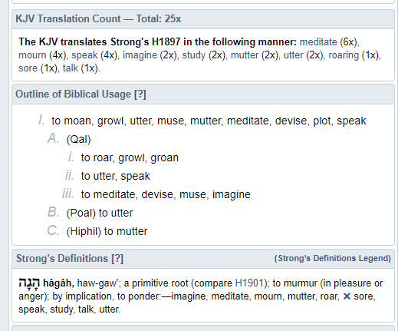
10. meditation

Slide 13
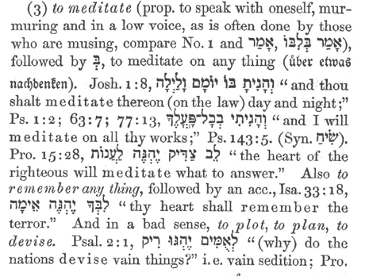
10. meditation

Slide 14
meditation
Joshua 1:8
This book of the law shall not depart out of thy mouth; but thou shalt meditate therein day and night, that thou mayest observe to do according to all that is written therein: for then thou shalt make thy way prosperous, and then thou shalt have good success.

Slide 15
Meditation
Holman Christian Standard Bible This book of instruction must not depart from your mouth; you are to recite it day and night so that you may carefully observe everything written in it. For then you will prosper and succeed in whatever you do. International Standard Version This set of instructions is not to cease being a part of your conversations. Meditate on it day and night, so that you may be careful to carry out everything that's written in it, for then you'll prosper and succeed. NET Bible This law scroll must not leave your lips! You must memorize it day and night so you can carefully obey all that is written in it. Then you will prosper and be successful.

Slide 16
meditation
PSALM 1
1. Blessed is the man that walketh not in the counsel of the ungodly, nor standeth in the way of sinners, nor sitteth in the seat of the scornful.
2But his delight is in the law of the LORD; and in his law doth he meditate day and night.
3And he shall be like a tree planted by the rivers of water, that bringeth forth his fruit in his season; his leaf also shall not wither; and whatsoever he doeth shall prosper.

Slide 17
meditation
Psalm 19:14
May the words of my mouth and the meditation of my Heart be acceptable in thy sight my Lord and my Redeemer

Slide 18
meditation
Phillipians 4: 8
Finally, brethren, whatsoever things are true, whatsoever things are honest, whatsoever things are just, whatsoever things are pure, whatsoever things are lovely, whatsoever things are of good report; if there be any virtue, and if there be any praise, think on these things. 9Those things, which ye have both learned, and received, and heard, and seen in me, do: and the God of peace shall be with you.

Slide 19
meditation
2 Timothy 3:16-17
But continue thou in the things which thou hast learned and hast been assured of, knowing of whom thou hast learned them; 15And that from a child thou hast known the holy scriptures, which are able to make thee wise unto salvation through faith which is in Christ Jesus. 16All scripture is given by inspiration of God, and is profitable for doctrine, for reproof, for correction, for instruction in righteousness: 17That the man of God may be perfect, throughly furnished unto all good works.

Slide 20
Listening
Key Points
The listening process involves five stages: receiving, understanding, evaluating, remembering, and responding.

Slide 21
Listening

Slide 22
Listening
Revelation 3:20
*Psalm 5:3
Matthew 7:24
James 1:19

Slide 23
Listening
Romans 10:14-17
How then shall they call on him in whom they have not believed? and how shall they believe in him of whom they have not heard? and how shall they hear without a preacher?
15And how shall they preach, except they be sent? as it is written, How beautiful are the feet of them that preach the gospel of peace, and bring glad tidings of good things!
16But they have not all obeyed the gospel. For Esaias saith, Lord, who hath believed our report?
17So then faith cometh by hearing, and hearing by the word of God.

Slide 24
Listening
Revelation 3:20
*Psalm 5:3
Matthew 7:24
James 1:19

